Slide 1


February 26, 2021
The Age of
Translating insights into trustworthy performance
IDC 2021 AI MarketScape – Briefing
All content protected under nondisclosure and may not be used or reproduced without the express permission of Deloitte.
All revenues are estimations in USD and include expenses. Numbers may have been rounded for reporting purposes.

Slide 2
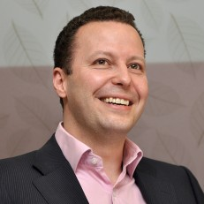




Briefing Participants
Costi Perricos
Irfan Saif
Nitin Mittal
Erica Volini
Margaret Martsching
Global AI Leader
US AI Co-Leader
US AI Co-Leader
Global Human Capital Leader
Analyst Relations
Global Lead

Slide 3










Market Leadership
4
TABLE OF CONTENTS
Market Journey
5
Key Takeaways
6
Reimagining Professional Services
7
Strategy-Led, Trustworthy & Sustainable Solutions
9
Rapidly Scaling AI Capabilities
11
Building New AI-Hybrid Operate Businesses
13
Tailored Sales & Delivery Models
15
Trailblazing the Path Forward
16

Slide 4
























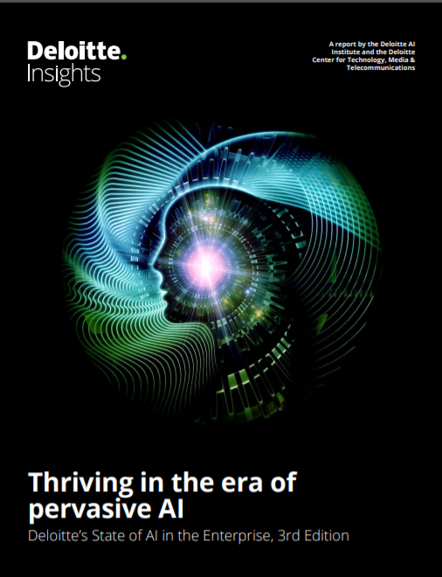
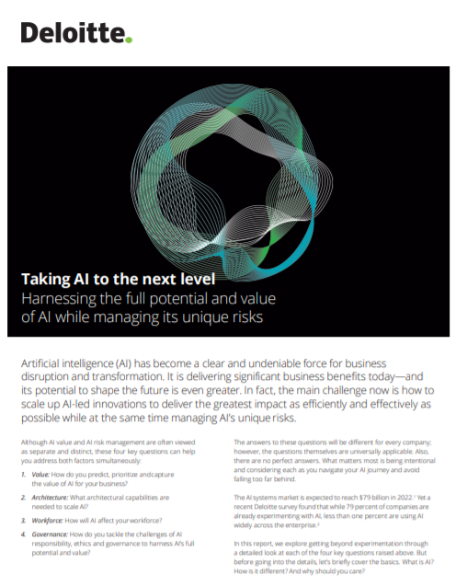






Market Leadership
We’ve progressed on our vision and are executing against the strategy we defined last year to remain the leader in AI
Overall AI
Performance
$1.4B
FY20 Year End
Revenue
30%
YoY
Revenue Growth
6,000
FY20 Year End
Headcount
25%
FY20 Year End
Operate Revenue Mix
$2.0B
Global Cloud, AI, and Cyber Investment
Launched innovative pre-sales capabilities to transform how we sell…
…and globalized the AI Fluency Program to upskill our talent…
…while expanding capabilities in augmenting talent through humans and machines.
Talent and Delivery Model
AI Greenhouse
Labs
Sales Engineering
Capability
AI Fluency
Program
SmartForceTM
Offerings and Go-to-Market
Scaled emerging AI capabilities…
…and AI-enabled large offerings…
…all backed by a robust Trustworthy AITM offering and assets.
Audit
Tax
D.Bias
AI Strategy
AI Foundry
Cyber AI
Platforms, Hybrid Assets, and Data
Scaled the CortexAITM platform…
…to power our portfolio of data rich, function-specific platforms and assets…
…connected through a seamless marketplace in Deloitte.AI.
OnSite AITM
CentralSightTM
Innovation and Ecosystems in Operate
Curated innovative ecosystem partnerships…
…to build new stand-alone AI Hybrid Operate Businesses…
…and launch the Center for AI Computing powered by NVIDIA DGX AI Supercomputer
Molecule-to-
Market
Smart
Factory
Digital Contact Center
Deloitte AI Institute
Published Marquee AI Research…
…and engaged AI Luminaries, Media, and Academics…
…through the Deloitte AI Institute globally.
State of AI in the Enterprise, 3rd Edition
Deloitte AI Institute
Nick
Thompson

Slide 5
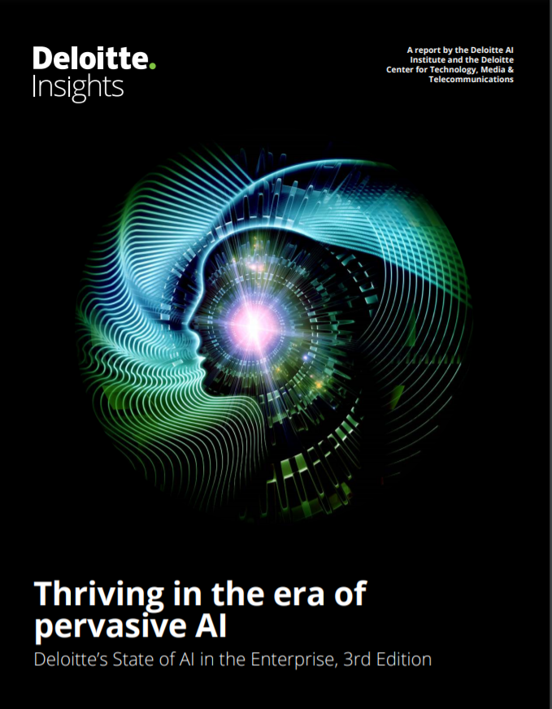
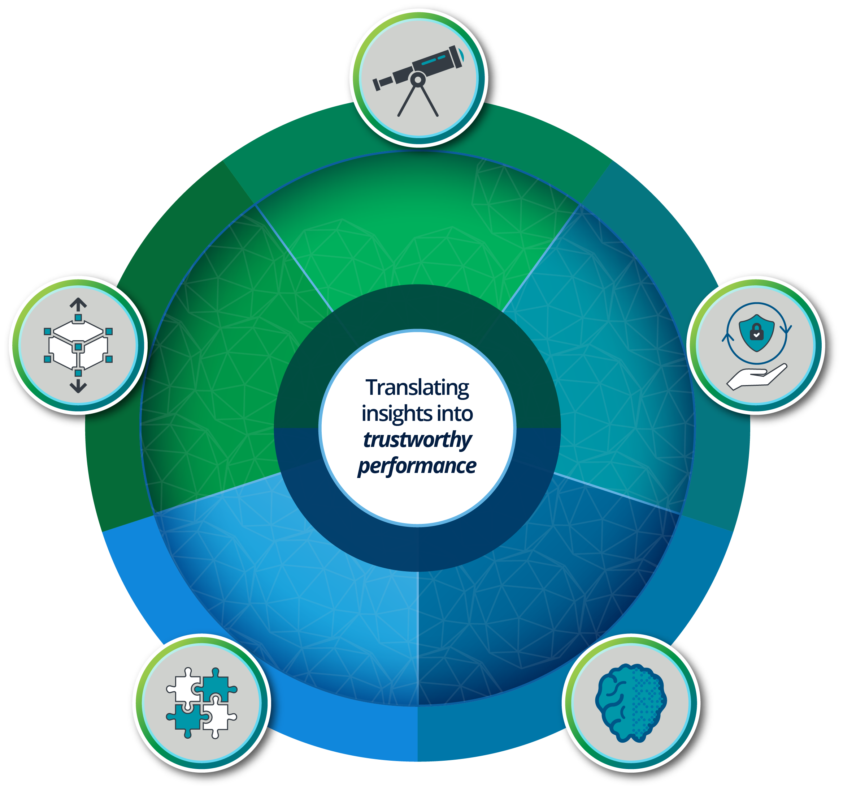



Market Journey
Each year, Deloitte surveys 2,700+ leaders in the market to get a pulse on buying behavior and emerging trends. The results of this market assessment inform and direct our offerings and investments in AI
We conduct a marquee study every year…
…that takes a pulse of the market…
…and informs our investments in AI
(Year-Over-Year comparison)
Gaining a competitive advantage…
64%
Believe that AI enables a competitive advantage over their competitors
5% decline
Growth in Business Value
Increasing investment and integration…
54%
Are spending 4x more than last year on AI initiatives
Deloitte AI Institute
Assets and Platforms
Deloitte Center for AI Computing
Core AI Capabilities
Hybrid-Operate Businesses
Talent & Workforce of the Future
74%
5% increase
74%
Plan to integrate AI into all enterprise applications within three years
26%
Catalyst for transformation…
<1%
76%
Anticipate that AI will substantially transform their organization within three years
2021
TECH
TRENDS
Tech-enabled strategy engineered for agility
Never trust, always verify: moving to cyber engineering
Data and tools to optimize the digital office
Core revitalization to enable strategic change
Data and infrastructure tuned for machine consumption
Seamless in-person and digital experiences
Supply chain agility through AI
MLOps to industrialize and scale AI deployment
Technology for diversity, equity, and inclusion
Source: State of AI in the Enterprise, 3rd Edition survey and 2021 Tech Trends

Slide 6
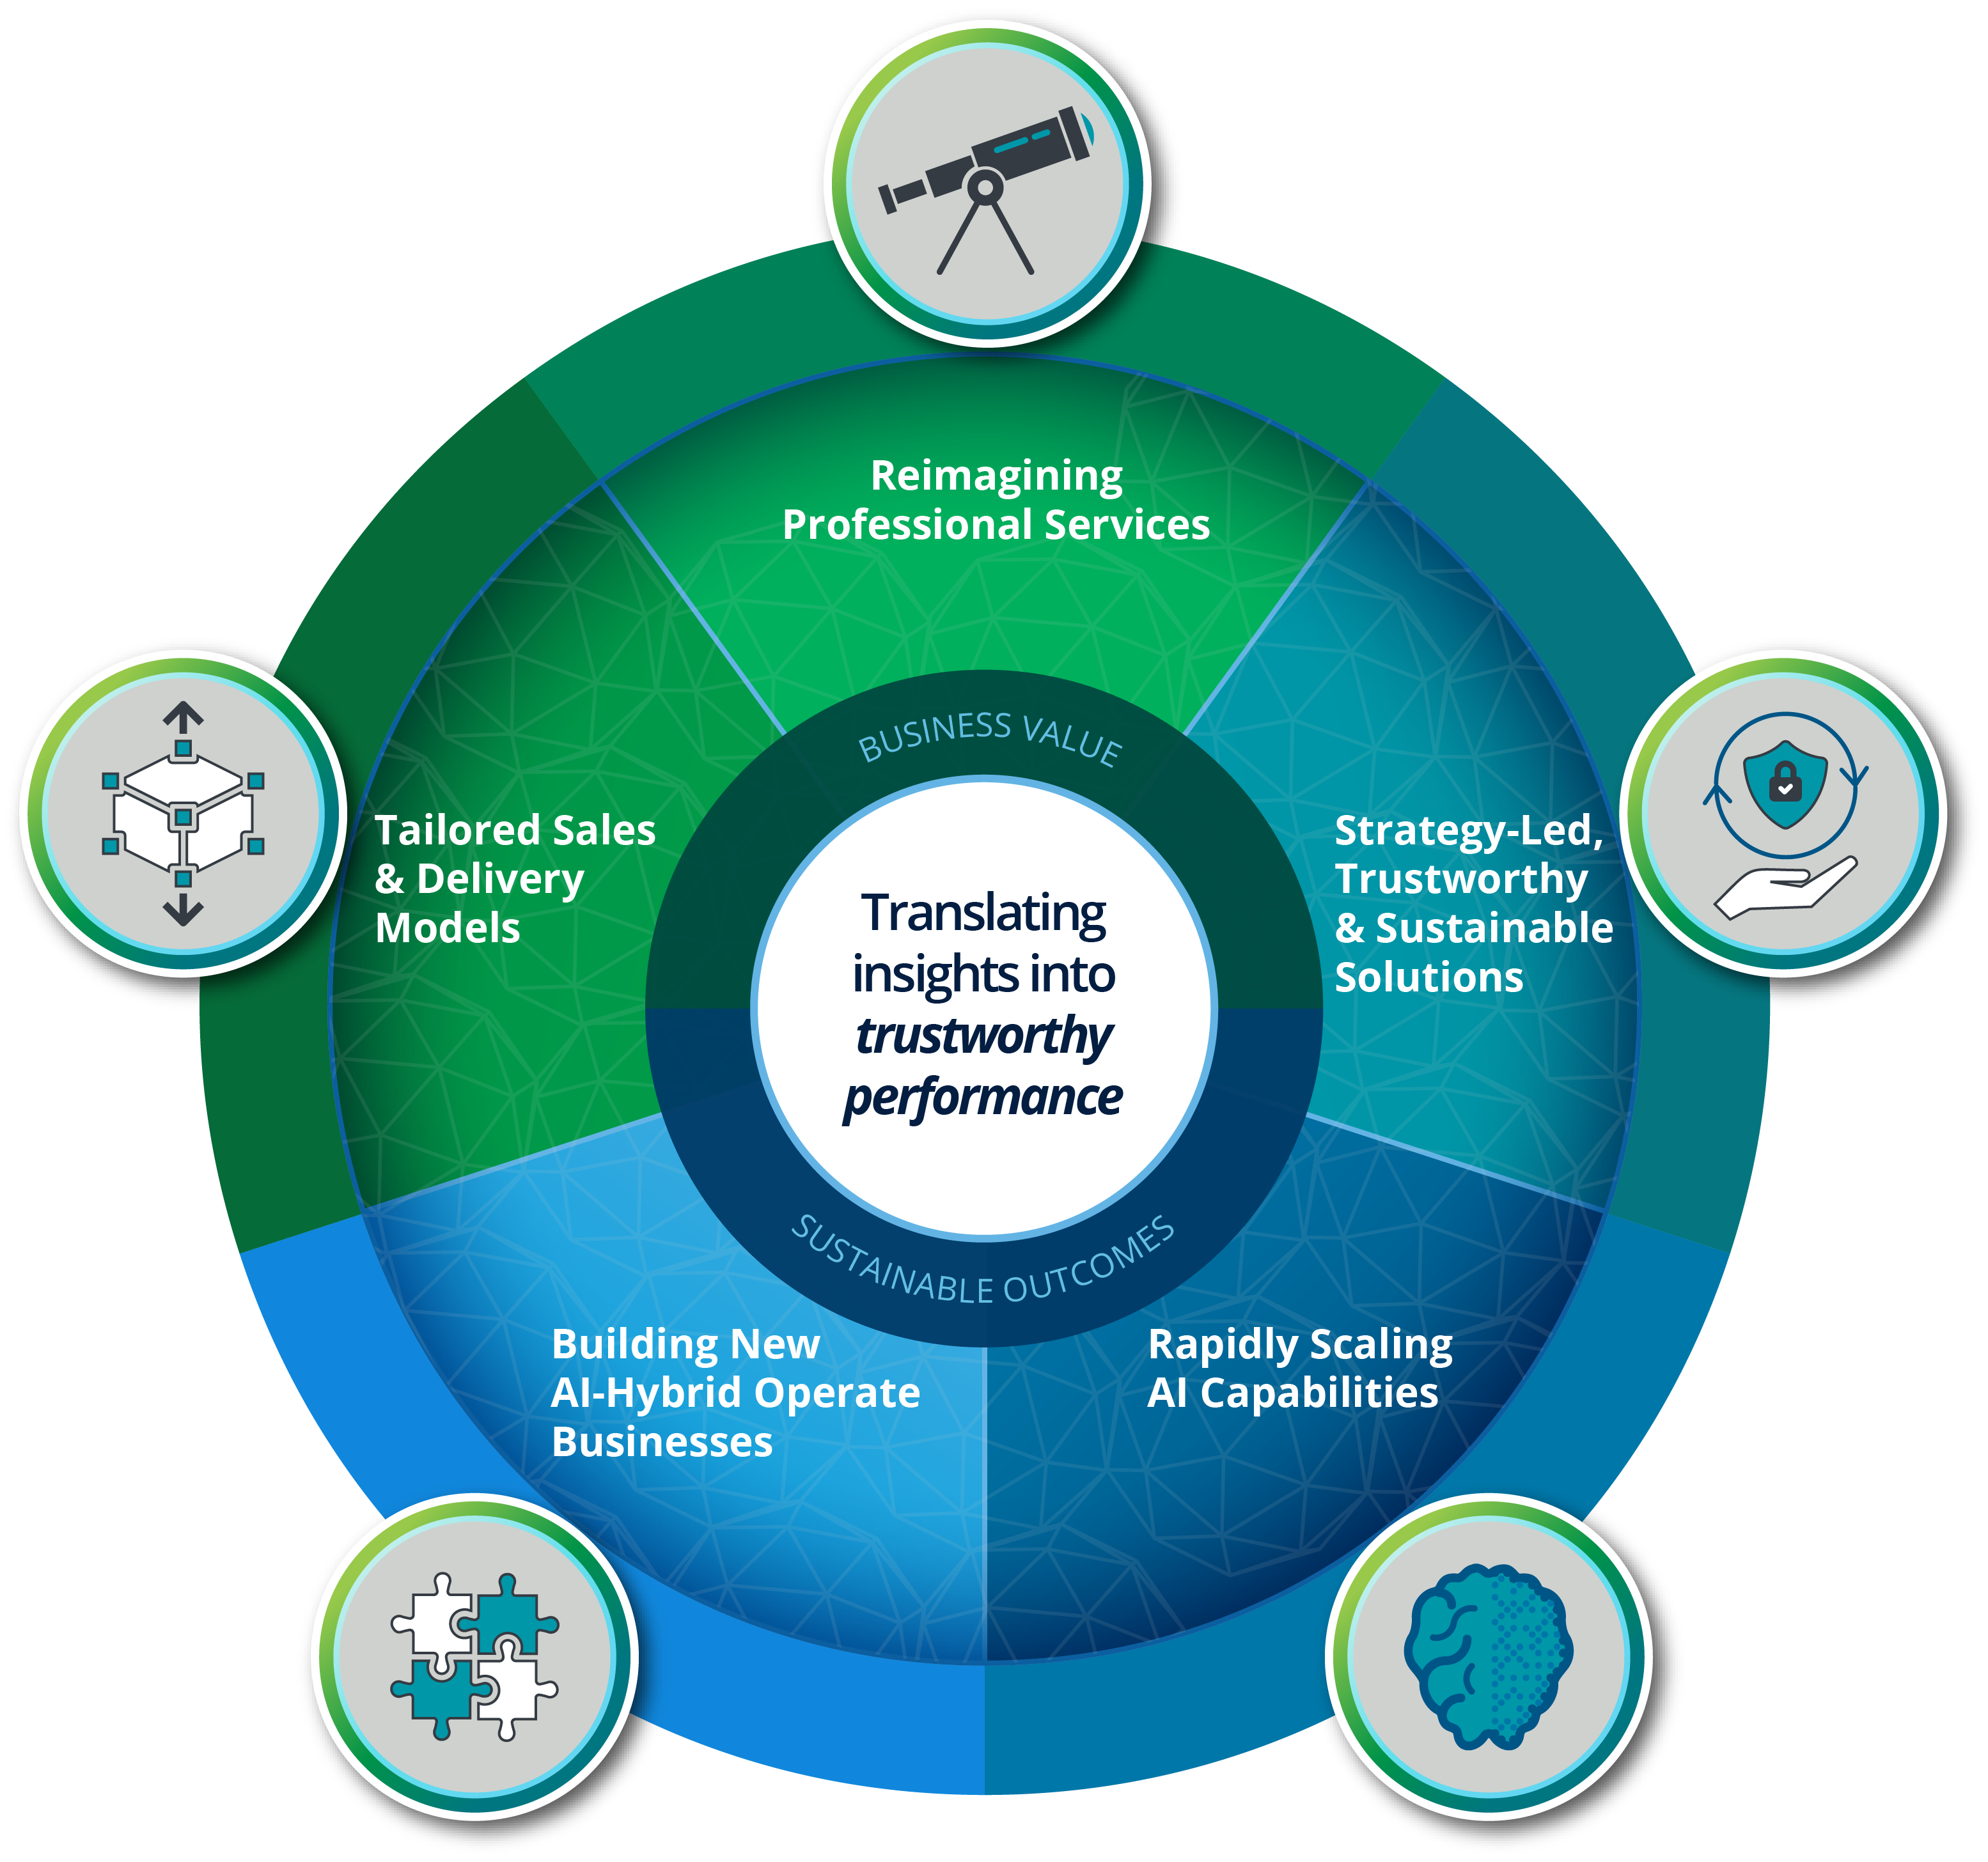
Key Takeaways
We are translating insights into performance across industries with our deep domain and technical expertise
Reimagining Professional Services
Building on our world-class consultancy foundation, we are reimagining how we sell and deliver professional services
Strategy-Led, Trustworthy & Sustainable Solutions
We deliver sustainable outcomes using a strategy and insights-led, human-centered approach backed by our Trustworthy AITM framework and change management capabilities
Rapidly Scaling AI Capabilities
We are rapidly scaling our end-to-end AI capabilities globally, enabling us to fuel our growth across the Advise-Implement-Operate (AIO) spectrum
Building New AI-Hybrid Operate Businesses
We are harnessing our ecosystem partners to scale new, fast-growing domain and industry-specific AI hybrid-operate businesses
Tailored Sales & Delivery Models
We are innovating our sales strategy, execution, and pricing to provide a leading customer experience for our clients

Slide 7











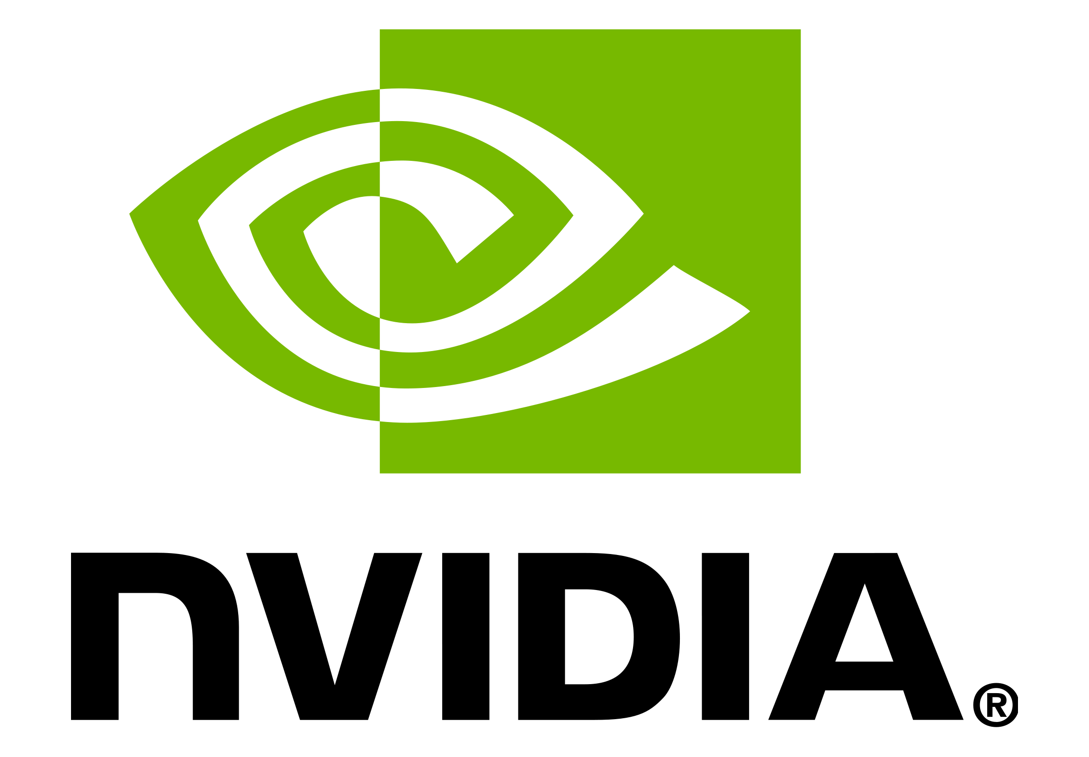
Reimagining Professional Services
Building on the foundation of our world-class consultancy and extensive depth and breadth across industries and domains – we are reimagining how we sell and deliver professional services
ENGAGE
DEPLOY
Provocative AI Thought Leadership globally
Game changing applied AI research across industries
Molding the future of AI through industry thought leaders, AI luminaries, and start ups
Global marketplace and storefront
Digitized, seamless, borderless buying experience and interface
Cloud-enabled end-to-end integration with existing systems
clients through the Deloitte AI InstituteTM
assets and offerings through the Deloitte.AI MarketplaceTM
DELOITTE
AI
State of AI in the
Enterprise
Andrew Ng
Nick Thompson
Global AI
Forums
POWER
INNOVATE
by platforms enabled by CortexAITM
AI platform for rapid design, development, deployment, and monetization of assets
Scalable, multi-cloud-based platform, comprised of market leading, plug-and-play AI technologies
Solves real business problems by infusing portfolio/industry knowledge into our domain-specific platforms: HUX, Omnia, Intela, and ConvergeHealth
through the Deloitte Center for AI Computing
First-of-its-kind center designed to accelerate the development of innovative AI solutions for our clients
Powered by a NVIDIA DGX AI Supercomputer
Turbocharging AI technologies from the research lab to industry
Copyright © 2021 Deloitte Development LLC. All rights reserved.
7

Slide 8
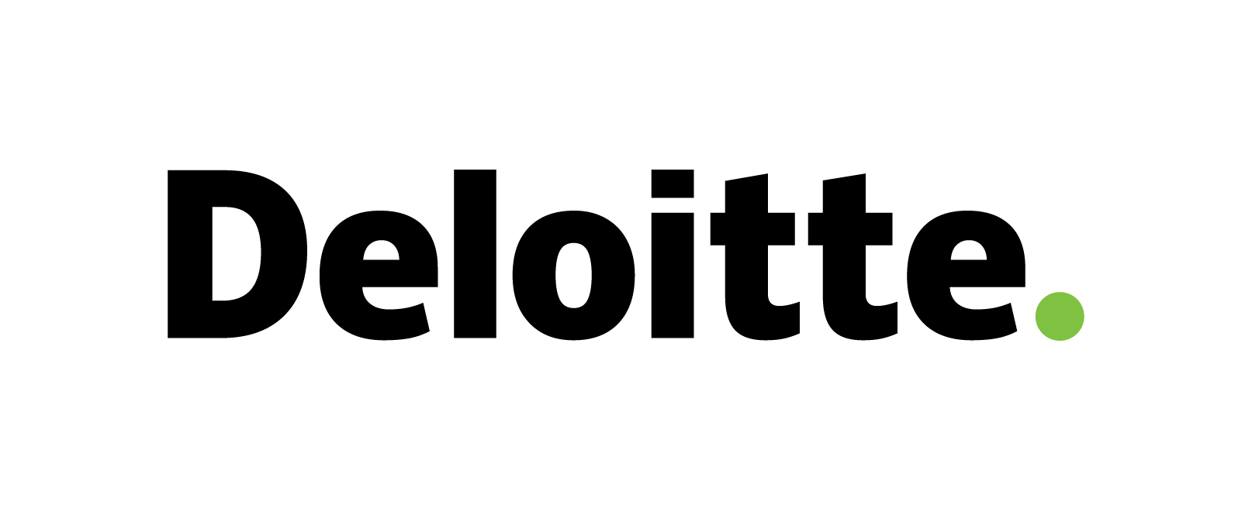
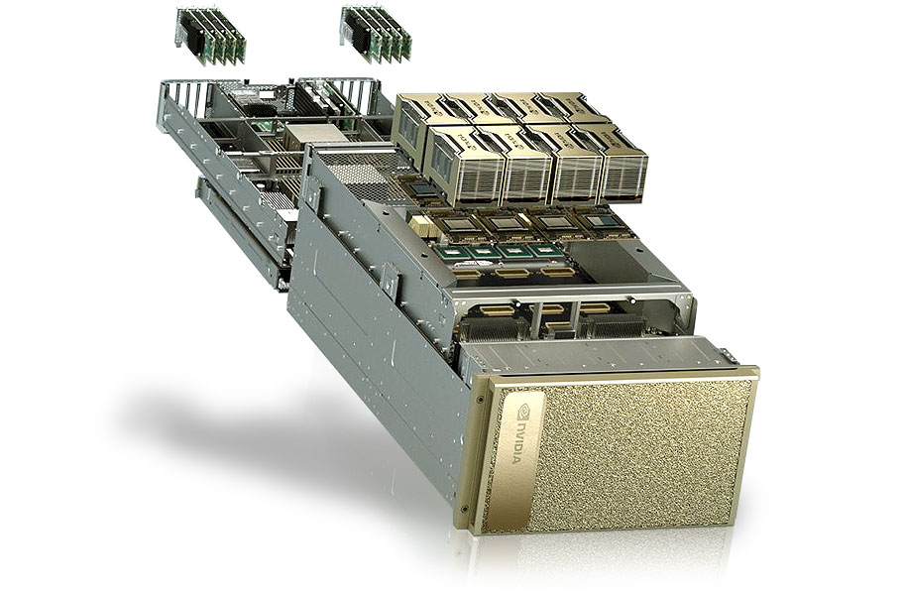







Deloitte Center for AI Computing
The Deloitte Center for AI Computing powered by a NVIDIA DGX AI Supercomputer is a first-of-its-kind Center designed to accelerate co-innovation with clients
Deloitte Center for AI Computing, Powered by a NVIDIA DGX AI Supercomputer
Accelerate Co-Innovation With Clients
AI and Business Expertise
Supercomputing Infrastructure
Develop experimental solutions and POCs not possible elsewhere:
AI and Data Science Talent
AI Hardware
Machine Learning Engineers
AI Architects
Front & Back-end Developers
NVIDIA DGX POD
48 GPUs for Experimentation
Connected & Autonomous Vehicles
Consumer Behavior Modeling
Green Energy Optimization
Mission AI for Government
Business and Strategy Expertise
Supercomputer Expertise
Sector and Domain Expertise
Change Management
Solution Development
Training and Bootcamps
Accelerates the work underway at existing R&D hubs including:
Intellectual Property and Assets
Solution Accelerators
Domain and Industry-specific Assets
AI Algorithms and Models
Pre-trained ML Models and Scripts
Industry Solutions Catalogue
AI Exploration Lab in Austin
AI Factory in Canada
Copyright © 2021 Deloitte Development LLC. All rights reserved.
8

Slide 9

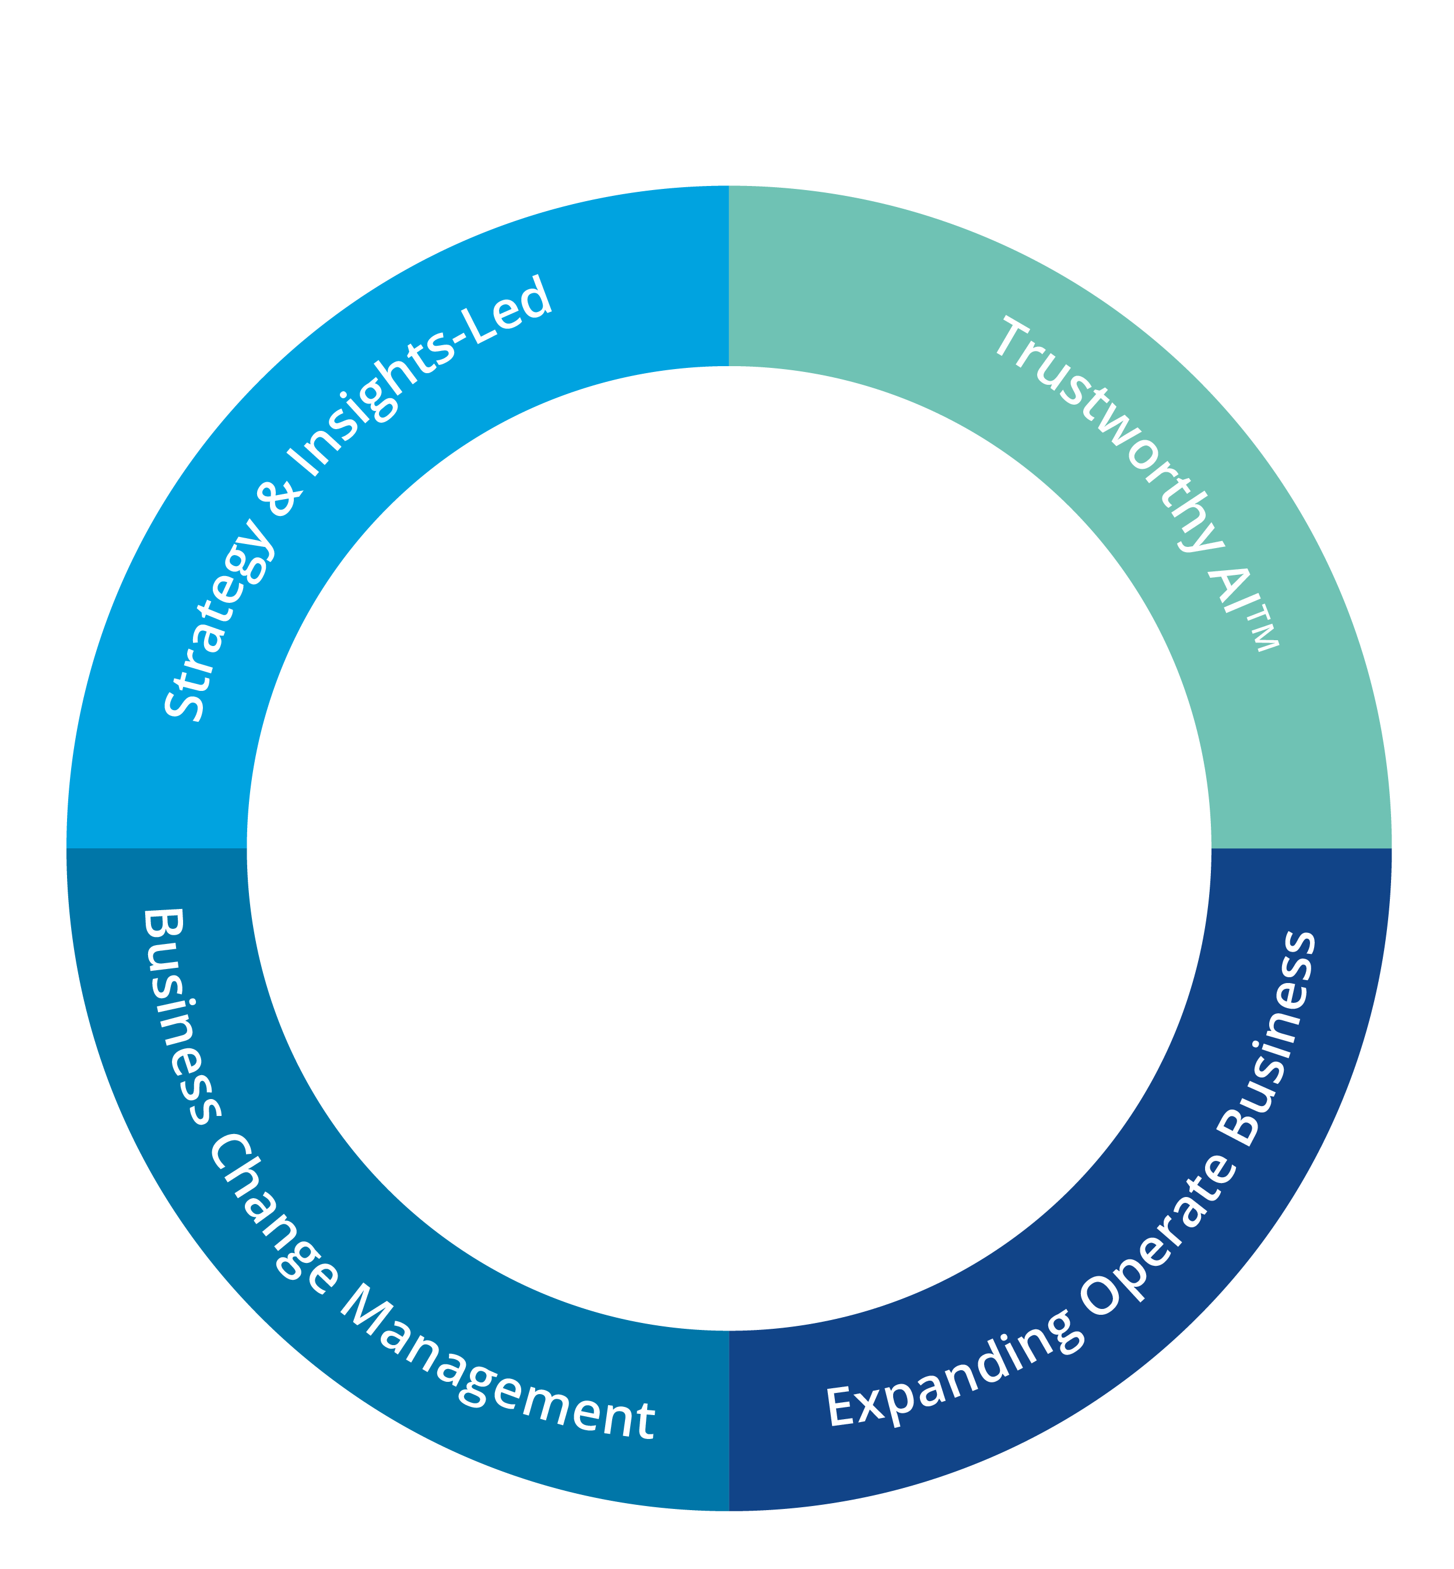

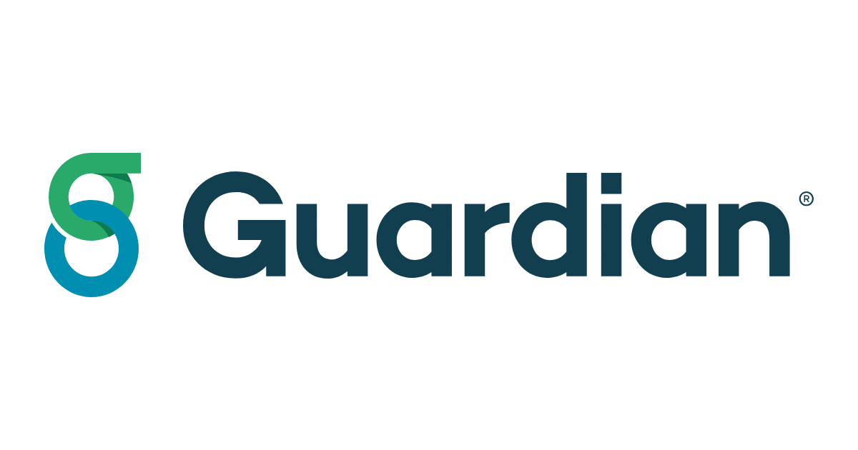


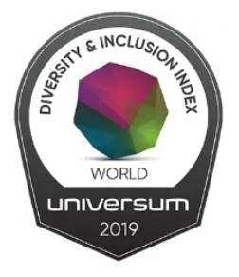
Strategy-led, Trustworthy & Sustainable Solutions
As trusted advisors, we drive impact with a strategy and AI insights-led, human-centered approach backed by our comprehensive Trustworthy AITM framework and world-class human capital and change management capabilities to deliver sustainable outcomes for our clients
We are transforming our clients to thrive in the Age of WithTM
Strategy & Insights-Led
Trustworthy AITM
Shaping leadership agenda with deep strategic capabilities
Leading with insights through industry & domain-specific expertise, assets, and data
Managing end-to-end transformations at scale by infusing strategy with AI
Embedding the Trustworthy AI Framework into every project
Co-developing Trustworthy AI assets and solutions with our clients
Shaping the policy on ethical use of AI
Trusted Advisor
InSightIQ
<Financial Holding Company #19 Logo>
Largest end-to-end professional services firm
Sustainable Outcomes
Business Change Management
Expanding Operate Business
Creating large scale, lasting transformational change in organizations
Upskilling our diverse, equitable, and inclusive workforce with the Global AI Fluency Program
Scaling the Talent Model of the Future
Global, firm-wide priority to scale our Operate business
Informing clients’ business decisions from Advise to Operate and Operate to Advise
Pioneering new Operate business models such as AI Foundry
AI Fluency
Program
Deloitte
Women in
Technology
Top 20 - Most Diverse & Inclusive Employer
and helping lead them to bigger and better sustainable outcomes
AI Foundry
SmartForceTM

Slide 10
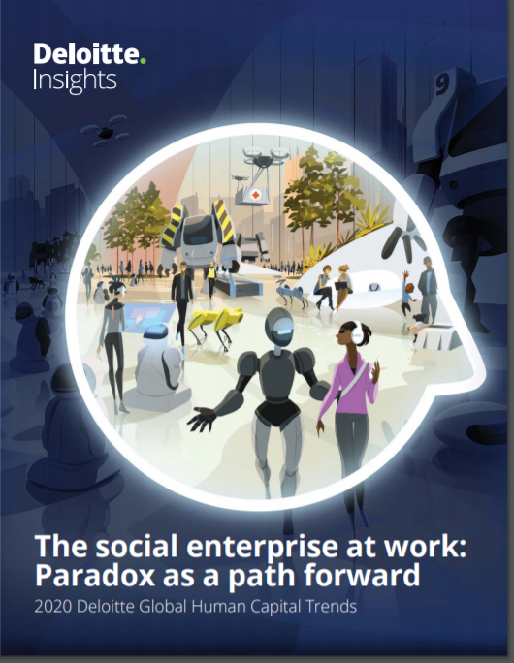
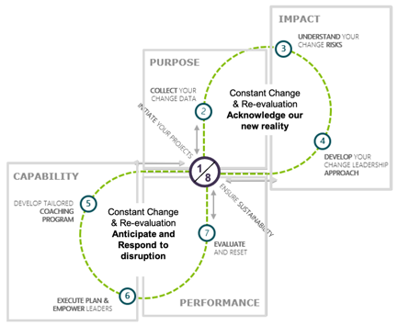

Business Change Management: Vision to Value
We bring our Vision to Value approach to all AI-based transformation projects to drive ongoing sustained outcomes in the Age of With
Human Capital Trends Report
Client Spotlight: Leading with a work-first approach to AI-based transformation
Department of Defence, Australian Government
Vision to Value: Our approach to change management
Work-first approach, behavior first mindset
Ongoing and continuous journey of embedding AI in the way organizations work
ChangeScout underpins our services
Our 2020 Global Human Capital Trends report draws on insights of nearly 9,000 survey respondents from 119 countries
It explores the greatest paradox of organizations: How to remain distinctly human in a technology-driven world?
We use the insights from our report as an input into our Vision to Value approach
ChangeScout
90%
Believe that ability to change at scale is critical to success, however only….
55%
…feel they are ready to change at scale
We take a “work-first” approach to deploy AI and drive ongoing sustained outcomes

Slide 11












Rapidly Scaling Our AI Capabilities
We are investing heavily in the next three years to rapidly scale emerging AI capabilities that will fuel Deloitte’s future growth
AI Strategy
Data-in-Motion
Intelligent
Automation
AI Insights &
Engagement
As the Art of Possible is shifting, we are rapidly scaling capabilities that enable us to fuel future growth for Deloitte globally
Acquired AI-focused companies
Hired strategic AI talent
Powered by CortexAI
Reinforced with Trustworthy AI
Delivered by the Talent Model of the Future
We are rapidly scaling capabilities that enable us to take full advantage of the opportunities created in a world of Humans with Machines
$250M invested
Powered by Cortex
Integrated with Trustworthy AI
Design and deliver strategy-led, data- and AI-fueled transformations to drive tangible value
Build the architectural services, talent, and development capabilities to deploy streaming data ecosystems
Use AI to drive business process transformation, cost reduction, and ERP value optimization
Harness the power of ML, conversational AI, vision AI, and tailored AI sector solutions to augment human capabilities
<Hospitality Service Provider #9 Logo>
<Electric Utility Company #2 Logo>
<Pharmaceutical Preparation
Manufacturer #31 Logo>
<Postal Services Provider #1 Logo>
<Bank Holding Company #1 Logo>
AI Foundry
Cloud ML
Cyber AI
Cognitizing our
Business
Provide cost-effective capacity and capability skilled in AI technologies, powered by assets, data, insights, and ecosystems
Help clients operationalize and scale their AI aspirations on Cloud architecture
Secure our clients’ environment to build trust in the community and with customers they serve
Cognitize how we deliver Audit and Tax services through AI-enabled delivery
<Insurance Holding Company #10 Logo>
<Diversified Insurance Company #3 Logo>
Large
Asset Manager
600+ clients
140+ Clients
<U.S, Department of Defense Logo>
2020 Audit Innovation of the Year
at the Digital Accountancy Forum & Awards
<Logistics Holding Company #1 Logo>
Copyright © 2021 Deloitte Development LLC. All rights reserved.
11

Slide 12

Client Spotlight: Global Devices & Platform Tech Company
Flexible deployment to support inhouse capacity to glean insights from petabytes of data
SITUATION
SOLUTION
Client launched new subscription business and needed to process petabytes of new daily data
Needed to enhance inhouse capability
7 incumbent support vendors focused only on “keeping the lights on” and not driving efficiency or innovation
Mobilized AI Foundry Capacity-as-a-Service model to augment client through both onshore and offshore resources
Replaced all 7 incumbent vendors with Deloitte services and capabilities
Scaled AI Foundry to 4 BUs focused on the client’s most pressing AI challenges
IMPACT
Provided superior business agility with an operating model that can re-focus data and AI resources
Generated insights that enable client to monitor health of new services and notable trends for timely and effective decision making. Examples include:
Rapidly detect and intervene on fraudulent activity by analyzing payments and device data
Reduce resolution time for service issues due to proactive anomaly detection
Monitor KPIs dynamically through stronger merchant engagement and greater retention
Lower media customer drop-offs by analyzing 1.5b records / day of redemption click data
Enabled faster insights through advances in data engineering and continuous integration and delivery capabilities to deliver timely data to data scientists and data analysts
7 →
Deloitte replaced 7 incumbent support vendors with Foundry services and capabilities
4x Insights
Faster time to insights and 4x growth in insights artifacts developed over a 6-month time period
75+ Resources
AI Foundry model has ramped up to 75+ resources in 18 months, supporting across 4 business units
Copyright © 2021 Deloitte Development LLC. All rights reserved.
Notes:
Tags: bubble, images, text

Slide 13






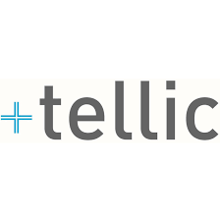














Building New Domain & Industry-Specific AI-Hybrid Operate Businesses
We are connecting together ecosystems to scale new, fast-growing, domain & industry-specific AI hybrid-operate businesses across the AIO spectrum
New AI-Hybrid Operate Businesses
Powering our AI-Hybrid Operate Businesses
Representative ecosystem partners
AIO Framework
Embedding AI across the advise-implement-operate lifecycle
Digital Controllership
Cross-Industry
Molecule to Market
Life Sciences
Delivered by
CortexAI
Industry &
Domain Specific
Powered by
SmartForce
Digital Contact Center
Cross-Industry
Solutions customized to the unique challenges of specific domains and sectors
Seamless delivery through our leading-class CortexAI platform
Radically changing delivery models through automation
Digital Banking as a Service
Financial Services
Smart Factory
Innovative Ecosystems
Manufacturing & Industrial Products
Orchestrating partnerships to address specific industry and domain business issues
Digital Twins
Cross-Industry
We are making bold investments in brand new, stand-alone businesses to solve our clients’ most pressing challenges

Slide 14


Client Spotlight: Large Telecommunications & Media Company
Delivered a first-of-a-kind Voice Virtual Assistant using advanced AI-based natural language tools and ML models
SITUATION
SOLUTION
Client looking to push the envelope in how finance function interacted with customers & stakeholders
Sought to build high-impact digital solutions for automation, fraud, and workforce management
Most recently, client was looking to improve Mobility Collections Performance in their call center
Global team developed an AWS-powered Voice Virtual Assistant (VVA) to directly engage with customers
Utilized advanced ML algorithms to improve existing collections models
Built new models to enable the VVA to negotiate with customers
IMPACT
Deloitte used the most advanced AI-based natural language tools and ML models to build a Voice Virtual Assistant that delivers a more efficient, engaging, and human-like customer experience
The VVA is able to engage with customers across multiple use cases, including making payments, setting up payment arrangements, and even negotiating with customers
VVA will handle an estimated 18 million calls every year, resulting in $30M+ in annual benefits
First-of-a-kind
Groundbreaking Finance Voice Virtual Assistant and first in the industry
$30 million+
Annual benefits through the application of advanced ML models and automation of contact center operations
18 million
Estimated number of calls the VVA platform will field every year
Copyright © 2021 Deloitte Development LLC. All rights reserved.
Notes:
Tags: bubble, images, text

Slide 15
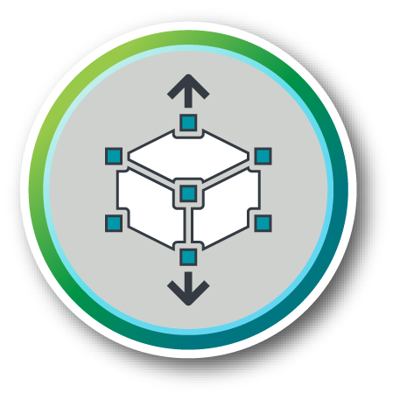








Tailored Sales and Delivery Models
We have the flexibility to create customized pricing and delivery models to meet the needs of our clients and the demands of the marketplace
SALES EXECUTION / PRICING
SALES STRATEGY
DELIVERY
Pursuit Center of Excellence
Sales Engineering
AI Labs, Forums, Academies
Alliances
Deal Structure
AI Talent
Tailored Delivery Model
Client & Industry Structure
Representative Examples
Customer Satisfaction
Sales Engineering
Deal Structure
Tailored Delivery Model
Insights
Traditional | Fixed Fee Time and materials Volume discount
Outcome-Based | Value (VBB) Fees at-Risk Satisfaction Fee
Metric-Based | Transaction-Based Milestone Based Shaped Payment Phase 1 investment
Managed | Operate-to-Innovate Subscription Bundled Solutions
Capacity Based | Flex Resource Capacity Crowd-sourcing
Generate data-driven hypothesized solutions to client problems
<Health Insurance
Carrier #1Logo>
Demos & Labs
Human With Machines
Immersing clients to bring our assets, solutions, and tools to life
SmartForce
Delivery Pools
Prototypes
AI Foundry
Demonstrate our capabilities to solve bespoke problems with AI
Enhancing customer satisfaction through an immersive pre-sales experience, creative deal structures, and tailored delivery models

Slide 16

Trailblazing the Path Forward
We imagine what’s possible in the Age of With, then translate insight into trustworthy performance
Reimagining Professional Services
Strategy-Led, Trustworthy & Sustainable Solutions
Rapidly Scaling AI Capabilities
Building New AI-Hybrid Operate Businesses
Tailored Sales & Delivery Models

Slide 17
APPENDIX

Slide 18


Our AI Offerings
Our investments in capabilities parallel our vision for professional services – we are rapidly scaling our capabilities and maintaining our leadership position in the AI and Data marketplace
Global AI Offerings
Operate
Domains
Industries
Platforms & Hybrid Solutions
Consumer & Marketing
Finance
Supply Chain
Operations
Workforce
M&A
Risk
Cyber
Consumer
Energy, Resources & Industrials
Technology, Media & Telecom
Life Sciences & Healthcare
Government & Public Services
Financial Services
Private Company Services
AI Strategy
Talent &
Change
Management
Cloud ML
Operate
Advise
AI
Transformation
AI Ethics & Governance
AI Foundry
AI Insights & Engagement
Cyber AI
Implement
Intelligent Automation
Line of Business
Data-in-Motion
Audit & Assurance
Consulting
AI-Enabled Innovation & Ecosystem Architecture
Risk & Advisory
Tax
Our globally consistent offering portfolio and extensive capabilities enable us to deliver unsurpassed business value to our clients across the globe

Slide 19

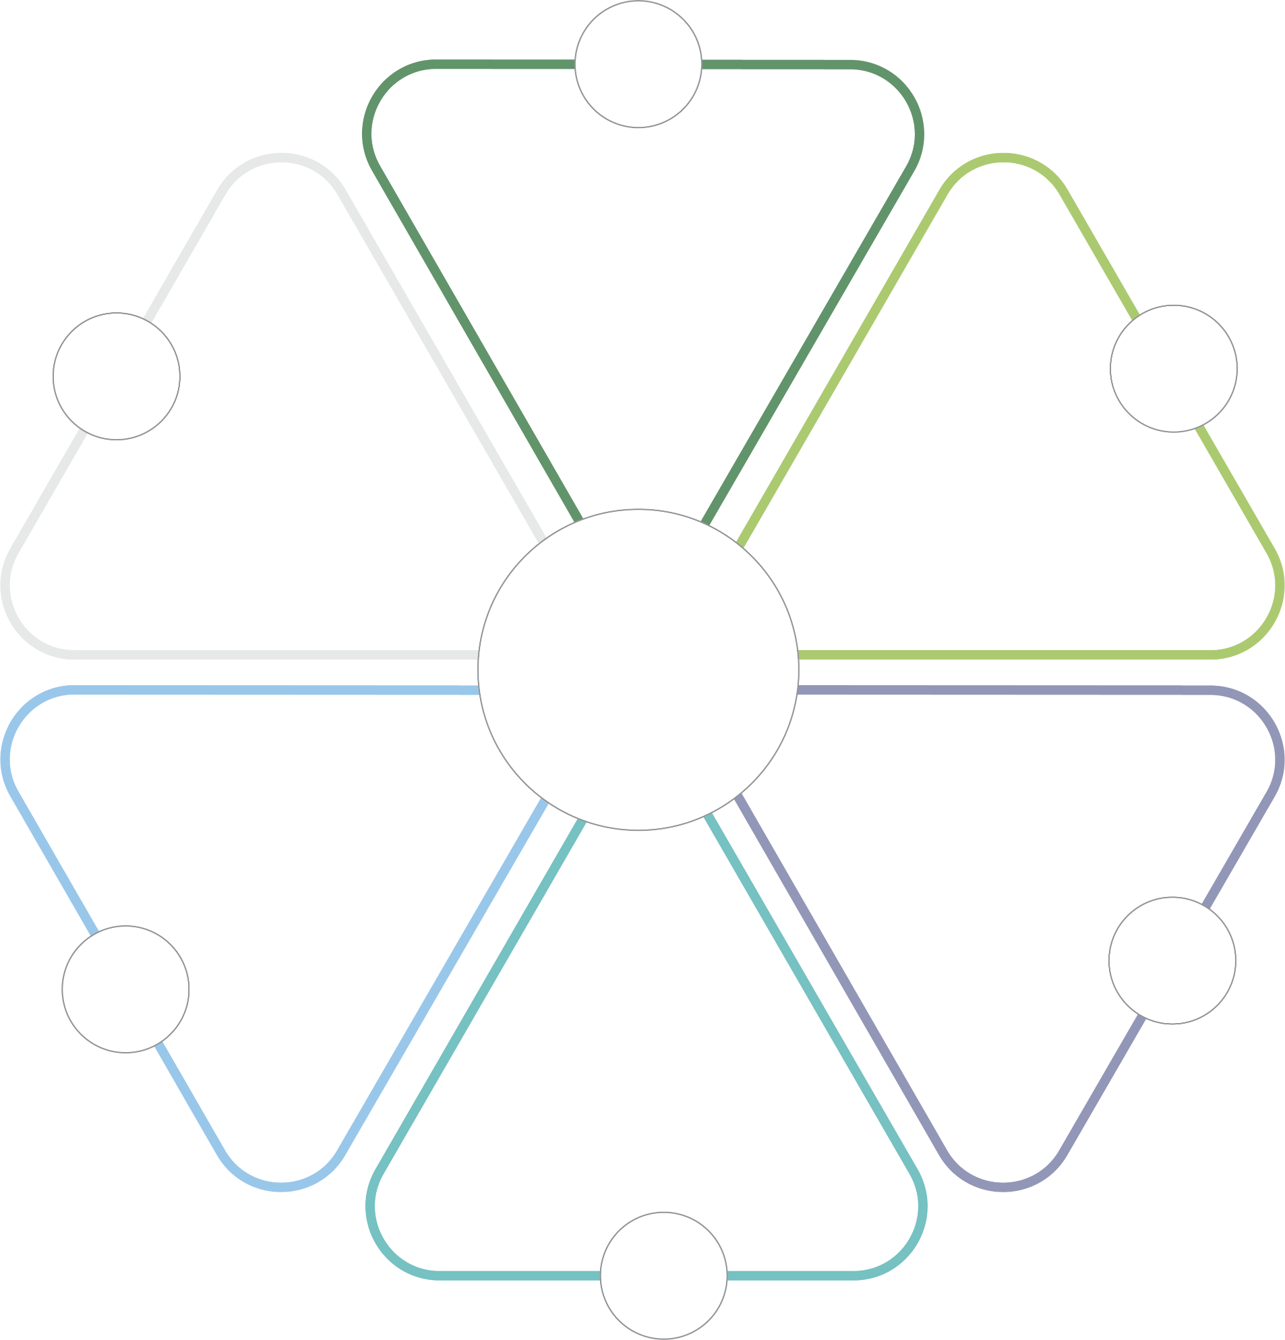


































Innovative Ecosystems
We orchestrate and curate innovative partnerships to address the most complex industry and domain business issues for our clients
Academic and Public Policy Organizations
Open Source Tools
Equipping our talent with open source Next Gen tools to democratize data science
Collaborating with academic and public policy organizations to shape tomorrow’s views
SEMOSS
Technology Vendors
Collaboration and Consortia
Curating innovative ecosystems to address our clients’
issues
Partnering with technology vendors to deliver new offerings and accelerated value to our clients
Collaborating with a consortium of industry focused organizations to bring innovation to our clients
300+ third party data sources
Data Sources
Start-up Ecosystem
Curating and delivering proprietary data to practitioners and clients across domains
MissionGraph
Tapping into the latest innovation through our Deloitte Catalyst AI ecosystem to innovate into the future
PredictRisk

Slide 20








Deloitte AI Institute
The Deloitte AI Institute helps organizations apply AI through cutting-edge research and innovation by bringing together the brightest minds in AI to help advance human-machine collaboration in the Age of With
The Deloitte AI Institute develops compelling thought leadership…
Igniting conversations with AI visionaries...
AI Ignition Series
64% of AI adopters said AI technologies will enable them to establish a lead over their competitors
<Non-Deloitte Person Image
Non-Deloitte Person Name>
<Non-Deloitte Person Image
Non-Deloitte Person Name>
<Non-Deloitte Person Image
Non-Deloitte Person Name>
<Non-Deloitte Person Image
Non-Deloitte Person Name>
State of AI in the Enterprise, 3rd Edition
Deloitte AI Institute
Connecting to academic research groups and start ups, molding the future of AI…
Shaping the conversation in industry leading conversations…
What separates analytical leaders from laggards
Berkeley – The House Fund
How CEOs can lead a data-driven culture
Amplifying a globally consistent, differentiated
Age of With message…
How Artificial Intelligence is combatting COVID-19

Slide 21

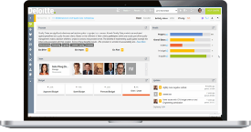
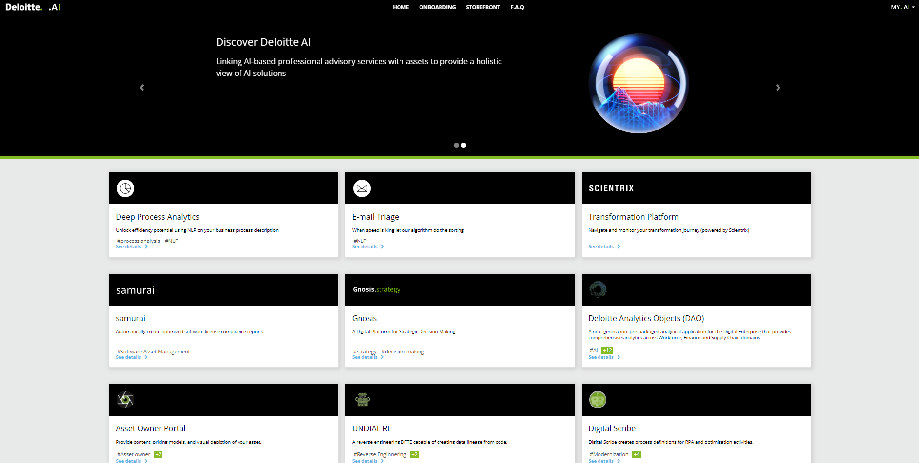

Deloitte.AI MarketplaceTM
Deloitte.AI is our global marketplace and storefront, with an underlying cloud-based deployment and delivery infrastructure, enabling rapid asset deployment for our clients and delivery teams
Legal & Commercial:
Streamlined legal and commercial agreements execution
Security:
Pen tested, CISO and data regulation compliant Security Layer
Deployment:
Fast and secure cloud deployment
AI-enabled Services:
Accelerated delivery of our core strengths, domain expertise and methodologies with AI-powered assets
Finances:
Digitized purchasing and billing process & integration with internal systems
Asset Scaling:
Accelerated scaling and global democratization of AI/ML in the cloud
Sales:
Increased asset visibility and reach
Service Management:
Rapid user provisioning and consumption measurement
www.deloitte.ai

Slide 22



CortexAITM
Hosted on a multi-cloud platform, including Azure and GCP, CortexAI can be quickly provisioned as a scalable, cloud-based platform comprised of market leading AI technologies
The CortexAI Advantage
CortexAI is an innovation platform that enables organizations to quickly operationalize and drive value while addressing specific business needs.
As a result, ROI can be delivered and recognized faster, saving money and time, as the platform and solution offerings surpass and optimize existing siloed data ecosystems.
Data Ingestion
ERP systems
External feeds
Legacy applications
Flat files
Data Transformation
Data extraction and loading
Data quality
Big data integration
Operational data store
Data Storage
Operational data store
Big data repository
In-memory database
Semi/unstructured
Columnar database
Data Science
Big data exploration
Emerging cognitive capabilities such as machine learning and AI
Advanced analytics
Intelligent Automation
Intelligent handwriting and text recognition combined with ML to process high volume structured to unstructured documents
Insights & Consumption
Visualizations
Reports
Dashboards
End users:
Secure web portal
Common Services
Micro-services architecture
Authentication, hosting, infrastructure, monitoring, and deployment
Multi-level Security
Scalability
Hosted on Multi-cloud Platform
Environment Administration
Plug-and-Play Code Libraries
Workflow Automation
Support Program
Less time managing data and more time acting on insights
Designed to evolve with the market, offering new benefits and features as available
Customizable and adaptable to the specific needs and environment of any organization or industry
Benefits
Measurable ROI in weeks, not years
Built-in flexibility, scalability, and security

Slide 23
Global AI Fluency Program
We are continuously upskilling our practitioners to thrive in the Age of With through our Global AI Fluency Program
PARTNER/PRINCIPAL/MD (PPMD) LIVE SESSIONS
Tailored content by Offerings and Sectors
AI FUNDAMENTALS eLEARNING MODULE
Cross-Business 1hr eLearning module focused on Age of With and introduction to AI
1
AI FLUENCY DAYS
SELF-SERVICE PPMD PATHWAY
Live session to educate all practitioners and Partner/Principal/MDs about Deloitte AI
Content to help PPMDs sell and GTM
CURRICULUM
SELF-SERVICE PRACTITIONER PATHWAY
Curated curriculum to educate practitioners on AI
2
AI UNIVERSITY WEBINARS
COMMUNITY EVENTS / CATALYSTS
Live webinars for all practitioners focused on specific AI topics
AI NEWSFEED
Weekly newsfeed of the latest AI news and market developments
AI Fluency
Program
AI IN A MINUTE
Short 2-3 minute videos focused on high level AI topics
AI COMPETITIONS
3
Hackathons and competitions
AI TREND CARDS
RESOURCES
2-pg placemats and FLIP cards focused on high level AI topics
AI LIBRARY
AI EXPERENTIAL LEARNING
Compilation of best-in-class Deloitte research on AI
Hands-on AI learning opportunities

